Slide 1
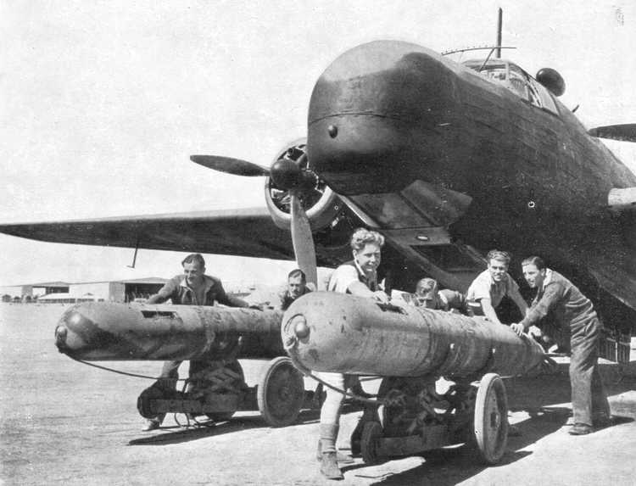
Hedy Lamarr

Slide 2
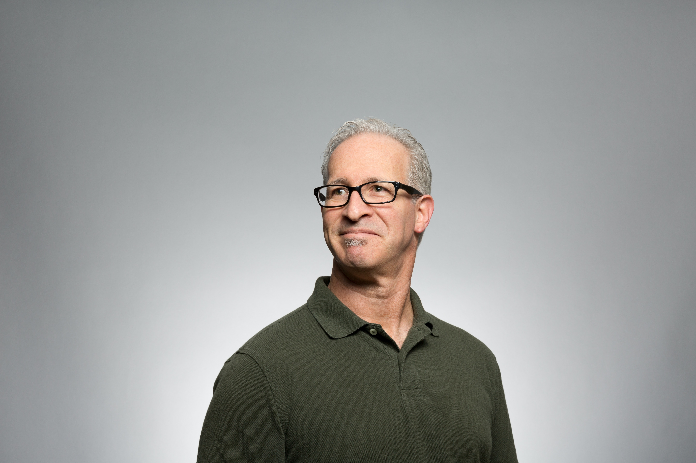
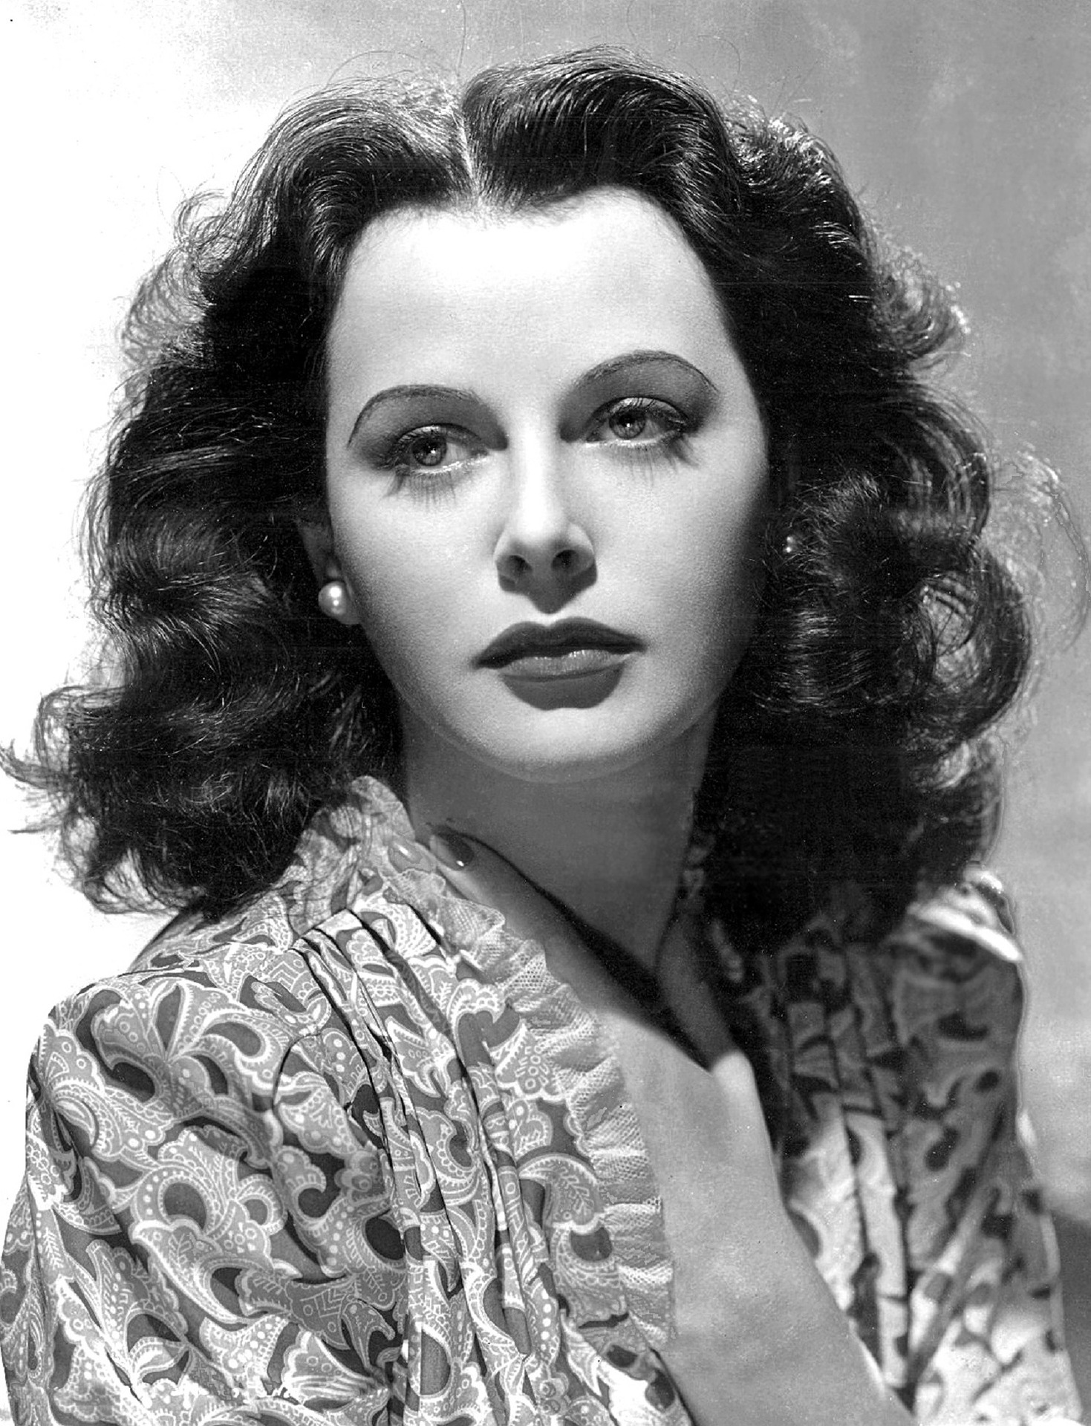
Hedy Lamarr was an inventor who worked out how to avoid the guidance systems of torpedoes becoming jammed by radio frequencies emitted by enemy ships. Which of these people do you think could be Hedy Lamarr?
Slide 1

Slide 3
What were you expecting?
Slide 2

Slide 4
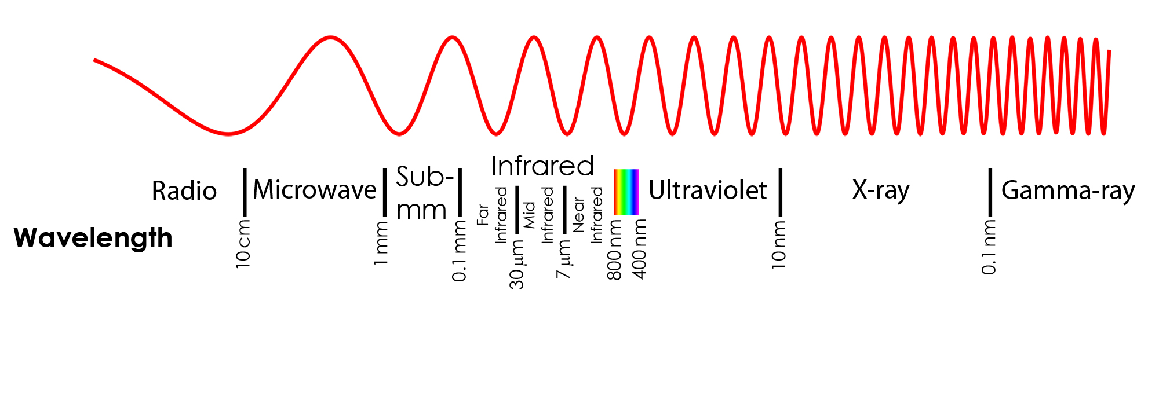
A type of energy, called electromagnetic radiation, travels in packets in a wave like motion.
Our eyes can detect some electromagnetic waves – we call this visible light.
Radio waves are low frequency. Our eyes cannot detect these.
Low frequency means fewer waves pass a particular place, in a given time.
Slide 3

Slide 5
Photo Credits: Image of Hedy -pixabay Other photos - Unsplash

